Slide 1
Azure IoT Adafruit Feather Huzzah ESP8266 Starter Kit Getting Started TutoriaL
Whew! That’s a mouth full!

Slide 2
Agenda

Slide 3
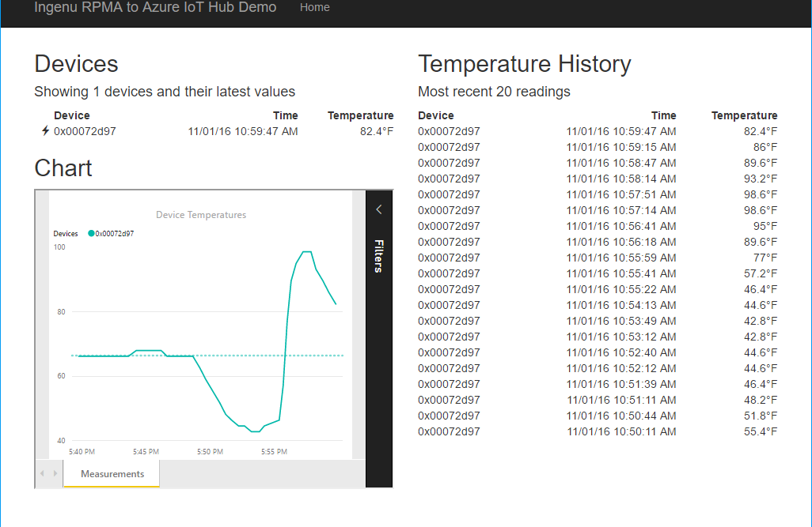
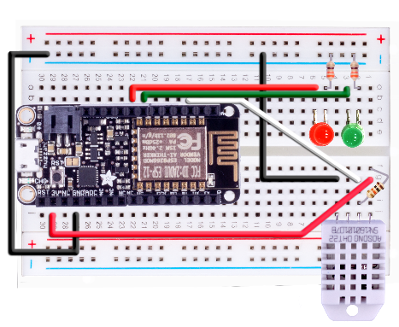
Resource Group <name>group
RENDER
App Service Plan ingenuplan
Function App <name>functions
GET
Web App <name>web
Function EventHub2IntellectRestJS
Function IntellectRest2IoTHubJs
QUERY
Service Bus Namespace <name>bus
Storage Account <name>storage
RECEIVE
Table
TempRecords
Event Hub
<name>alerts
Send Cloud to Device Msg Via Hub
OUTPUT
OUTPUT
Stream Analytics Job <name>job
AZURE
INPUT
Solution Architecture
IoT Hub <name>hub
Device to Cloud
Cloud to Device
DEVICE

Slide 4




Slide 5
IoT Logo

Slide 6
arduino

Slide 7
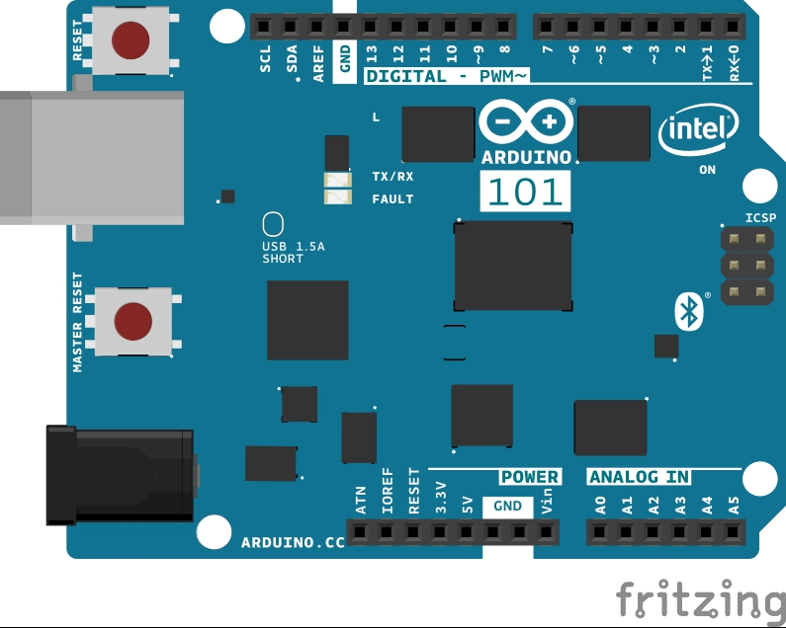
Arduino 101

Slide 8
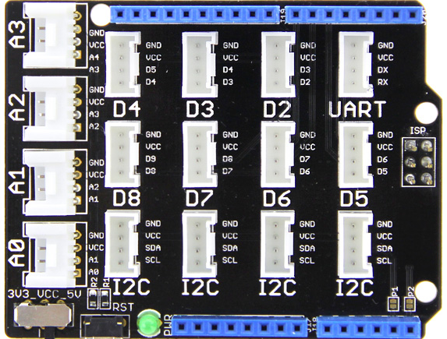
Grove Base Shield

Slide 9
Grove cable & SENSORS

Slide 10
Grove cable & SENSORS

Slide 11
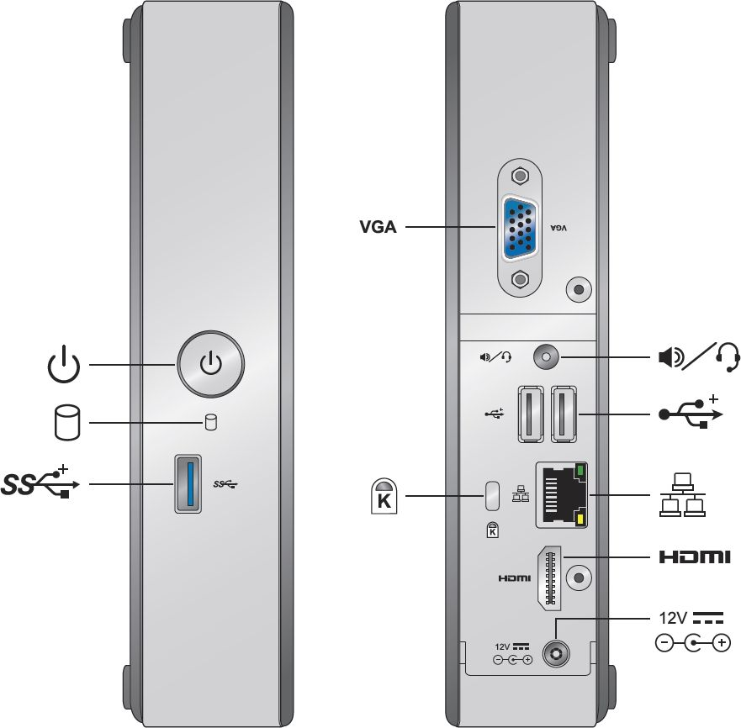
INTEL NUC DE3815TYKE

Slide 12
GALILEO BOARD

Slide 13
RASPBERRY PI

Slide 14
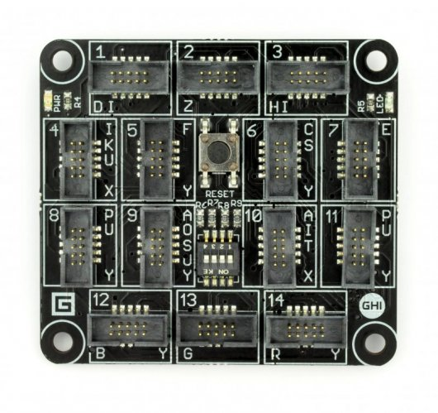
FEZ SPIDER MAIN BOARD

Slide 15
Sparkfun weather shield

Slide 16
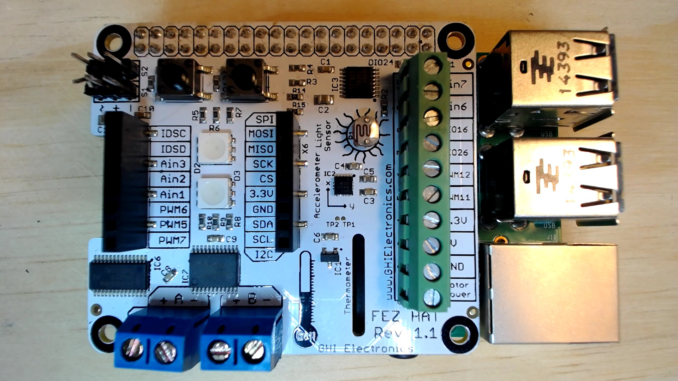
FEZ HAT

Slide 17
Connect the dots azure icons
Event Hubs
Stream Analytics
Storage
(
Azure
Microsoft Azure
Web App
Service Bus
)
Storage blob
Storage table
SQL database
HDInsight
Machine
(
Learning
GitHub code
Git repository
generic
)

Slide 18
LEDs

Slide 19
Resistors
220Ω
1st Digit
2nd Digit
Multiplier
Tolerance
Color | Name | 1st Digit | 2nd Digit | Multiplier | Tolerance
 | Black | 0 | 0 | X1
 | Brown | 1 | 1 | X10 | 1%
 | Red | 2 | 2 | X100
 | Orange | 3 | 3 | X1,000
 | Yellow | 4 | 4 | X10,000
 | Green | 5 | 5 | X100,000
 | Blue | 6 | 6 | X1,000,000
 | Violet | 7 | 7
 | Grey | 8 | 8
 | White | 9 | 9
 | Gold |  |  | X0.1 | 5%
 | Silver |  |  | X0.01 | 10%
330Ω
10KΩ

Slide 20
cables

Slide 21
More cables and adapters

Slide 22

LEDs
Anode (+)
Cathode (-)
Flat Edge
Small Post
Big Post
Long Leg
Short Leg
Vcc (+)
GND

Slide 23
LEDs

Slide 24
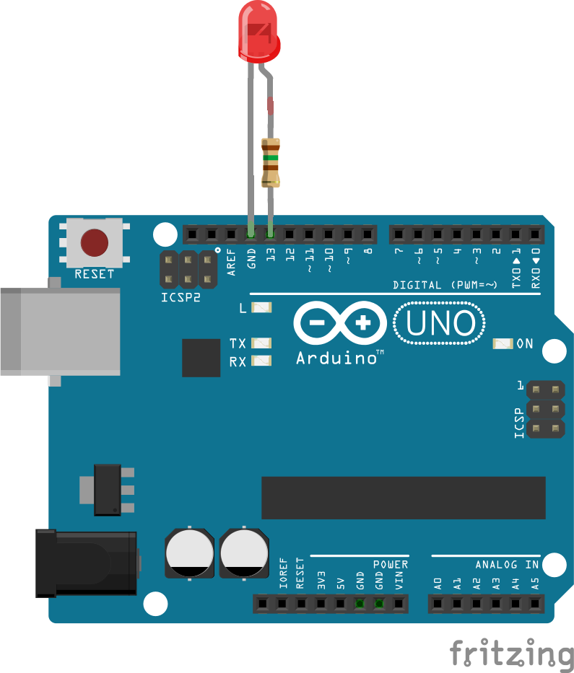


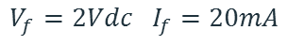
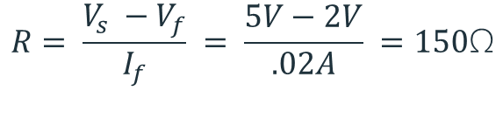
Current limiting resistors
Providing more current than an LED is rated for can destroy the LED. To prevent that, you should use a “Current Limiting” resistor.
To calculate the value of the resistor you need to know the supply voltage (Usually 5V on the Arduino Uno), and the LEDs rated Forward Voltage (the voltage drop across the LED) and Forward Current (the maximum current the LED can handle).
$$V_{f}=2Vdc I_{f}=20mA$$
$$Resistor Value (R)= \frac{Supply Voltage \left(V_{s}\right)−LED Forward Voltage (V_{f}) }{LED Forward Current (I_{f})}$$
$$V_{s}=5Vdc$$
$$R= \frac{V_{s} −V_{f}}{I_{f}} = \frac{5V−2V}{.02A} =150\text{Ω}$$
The Arduino Uno has a built in current limiting resistor on Pin 13. If you use Pin 13 to power your LED you can use it without a separate resistor.

Slide 25
Resistors
220Ω
1st Digit
2nd Digit
Multiplier
Tolerance
Color | Name | 1st Digit | 2nd Digit | Multiplier | Tolerance
 | Black | 0 | 0 | X1
 | Brown | 1 | 1 | X10 | 1%
 | Red | 2 | 2 | X100
 | Orange | 3 | 3 | X1,000
 | Yellow | 4 | 4 | X10,000
 | Green | 5 | 5 | X100,000
 | Blue | 6 | 6 | X1,000,000
 | Violet | 7 | 7
 | Grey | 8 | 8
 | White | 9 | 9
 | Gold |  |  | X0.1 | 5%
 | Silver |  |  | X0.01 | 10%
330Ω
10KΩ

Slide 26
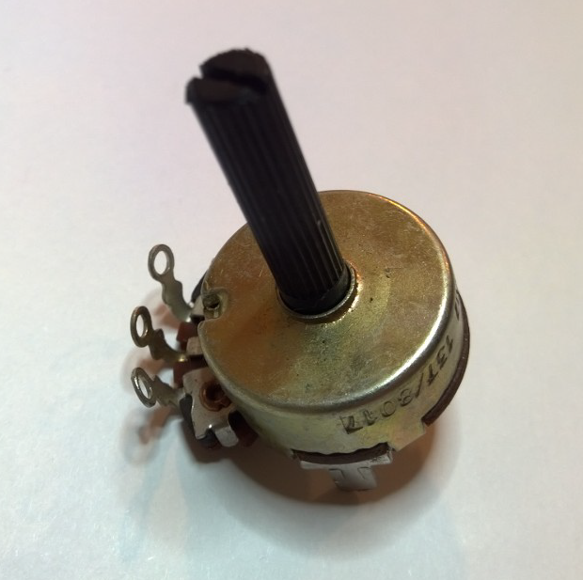
Potentiometer – variable resistor

Slide 27
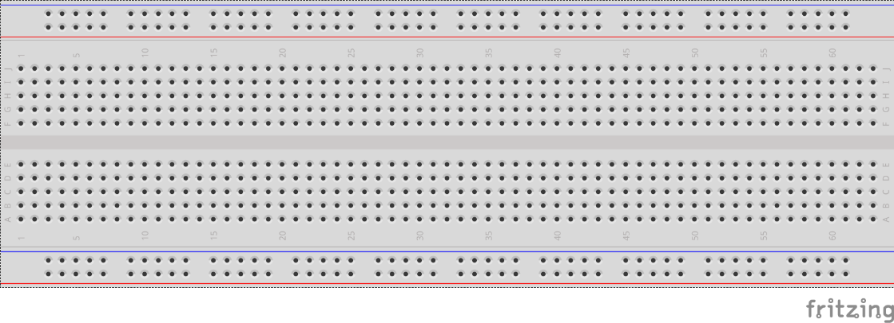
breadboards
Breadboards offer a great way to prototype circuits. The provide a number of “buses” for connecting both power and components.
Power buses run the entire horizontal length
Component buses give you easy ways to connect pins together

Slide 30
Micro SD Cards
Font: Segoe UI Semibold

